Slide 1
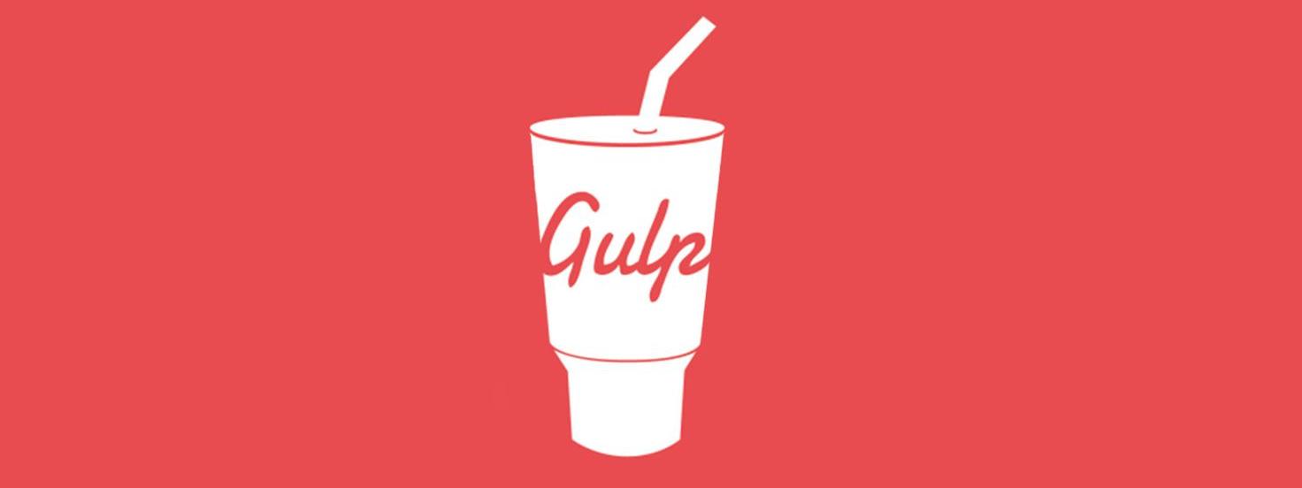
AngularJS
gulp

Slide 2
What is gulp
gulp is a toolkit for automating painful or time-consuming tasks in your development workflow
Other well-known automating tools for JavaScript ecosystem
Grunt (older than gulp)
webpack (newer than gulp)
and for other languages (Java):
Ant
Maven
Gradle

Slide 3
Typical usages of gulp
Run development server (auto-reload)
Build for production (minification)
Run automated tests
Manage versions (changelog, .json, git tag…)
Use templating & auto-inject

Slide 4
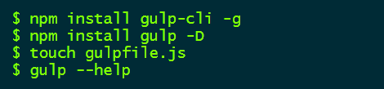
How to use gulP?
gulp is a npm package:
Gulp main file is “gulpfile.js”.
More files can be used for more complex projects (often in a /gulp directory)

Slide 5
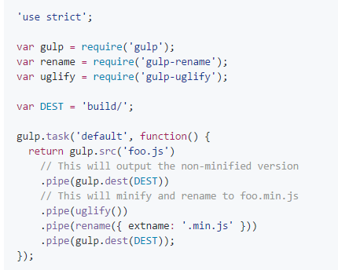
Basic gulp script
gulpfile are written in javascript

Slide 6
Gulp main concepts
gulp.task(): a set of instructions that can be called externally or internally
name
dependencies
function

Slide 7
Gulp main concepts
Important precision on dependencies:
They will all run in parallel!
Here “clean” will run at the same time as “compile” and “minify”… this is NOT what you want!
gulp.task('mytask', ['clean', 'compile', 'minify'], function() {
// Do stuff
});

Slide 8
Gulp main concepts
gulp.src(): Emits files matching provided glob or an array of globs. Returns a stream of Vinyl files that can be piped to plugins
Input files
String or array, using glob
Syntax

Slide 9
Gulp main concepts
pipe(): a step that is executed as a part of a tasks
plugin function call

Slide 10
Gulp main concepts
Plugin call: different for each plugin

Slide 11
Gulp main concepts
gulp.dest(): Can be piped to and it will write files. Re-emits all data passed to it so you can pipe to multiple folders. Folders that don't exist will be created.
Destination folder

Slide 12
Running tasks
To run the “default” task
$ gulp
To run a specific task
$ gulp <taskname>
$ gulp build
To run multiple tasks
$ gulp <taskbname1> <taskname2> …
$ gulp clean build run
Warning! Tasks will run in parallel!

Slide 13
How to run tasks in a specific order?
Use the run-sequence plugin : https://www.npmjs.com/package/run-sequence
gulp.task('build', function() {
runSequence('build-clean', 'build-scripts', 'build-styles', 'build-html');
});

